Slide 1

Object Detection With
v5
Group C
Kyler Martinez, Ruben Gutierrez, Austin Vinh Tran, Nelson Chong

Slide 2
What is YOLO?
“You Only Look Once”
Object Detection Framework.
Regression-based algorithm as opposed to classification-based algorithms.
YOLOv5 is the 5th version of YOLO that uses Focus structure with CSPdarknet53 as a backbone.
YOLOv5 classifies images using a grid and predicts where to place bounding boxes.

Slide 3
Performance Metrics
Inference Time: The time it takes for forward propagation in milliseconds.
Inference Time = FLOPs / FLOPS.
FLOPs is the number of floating point operation.
FLOPS is the number of floating point operations per second.
Frames per second (FPS)
FPS = 1 / Inference Time.
Power Consumption: A watt meter is used to measure the power consumption in Watts.
Power Consumed = Average Power Reading - Idle Power.
Device Used: KUMAN Power Meter KW47
Software Used: Core Temp

Slide 4
YOLO On A Desktop
Two Tests:
Process Image from File:
Process from file is slightly slower than camera
Draws more power than camera
Process Image from Video:
Processes images slightly faster than the camera
Draws less power than file
Results: | Process from File | Process from Camera
Average FPS | 100.1 | 125
Average Inference Time | 9.99 | 8.00
Average Power | 31.425 | 12.075

Slide 5
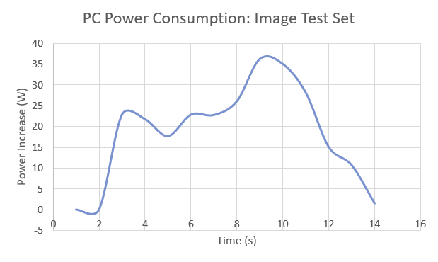
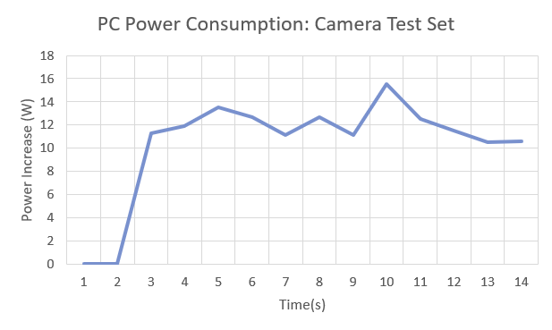
YOLO On A Desktop
Idle Power
Image: 21.5W
Camera: 18.7W
Average Power Consumed
Image: 52.925W
Camera: 30.775W
Power Consumed
Image: 31.425W
Camera: 12.075W

Slide 6
YOLO on a Laptop
Two tests:
Process Images from File:
Process from file is faster than the live camera feed.
Draws more power than the live camera feed.
Live Camera Feed:
Slower than process images from file.
Consumes less power.
Results: | Process from File | Process from Camera
Average FPS | 4.81 | 4.11
Average Inference Time | 208.02 | 243.18
Average Power | 16.3 | 14.13

Slide 7
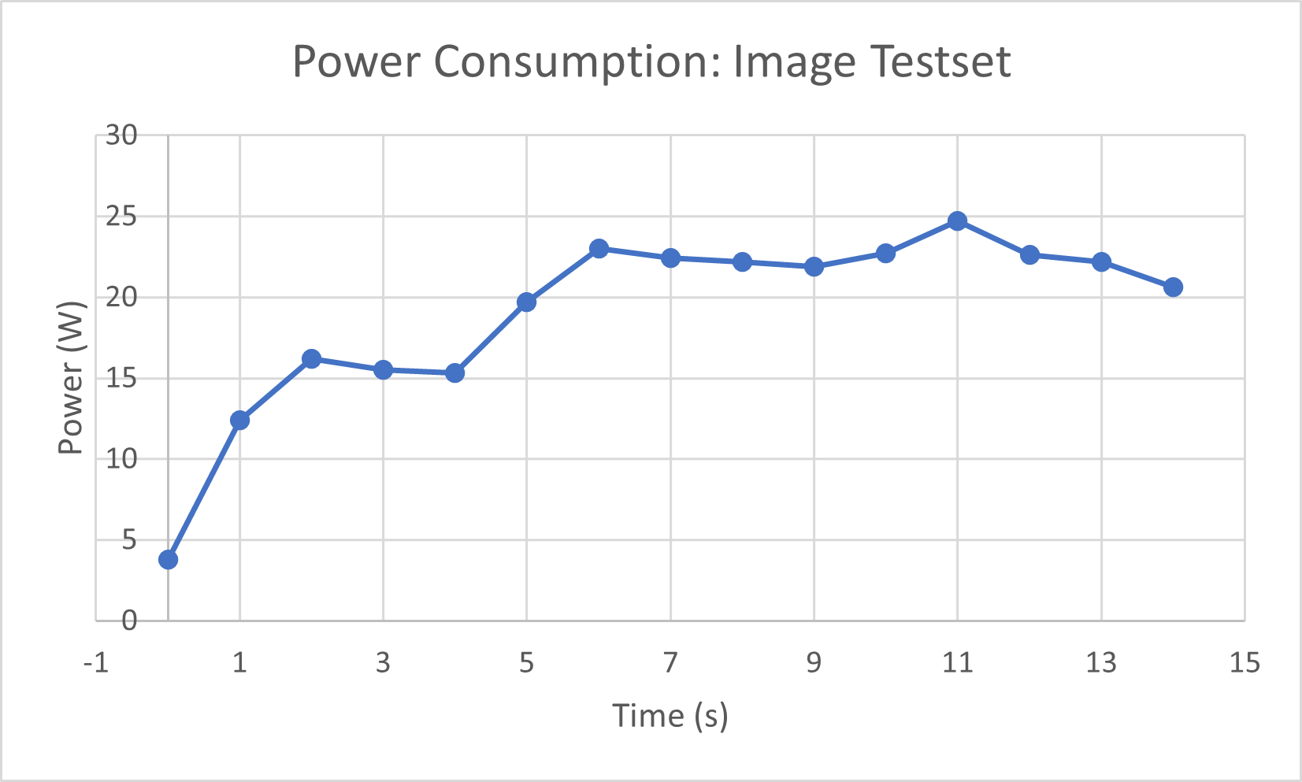
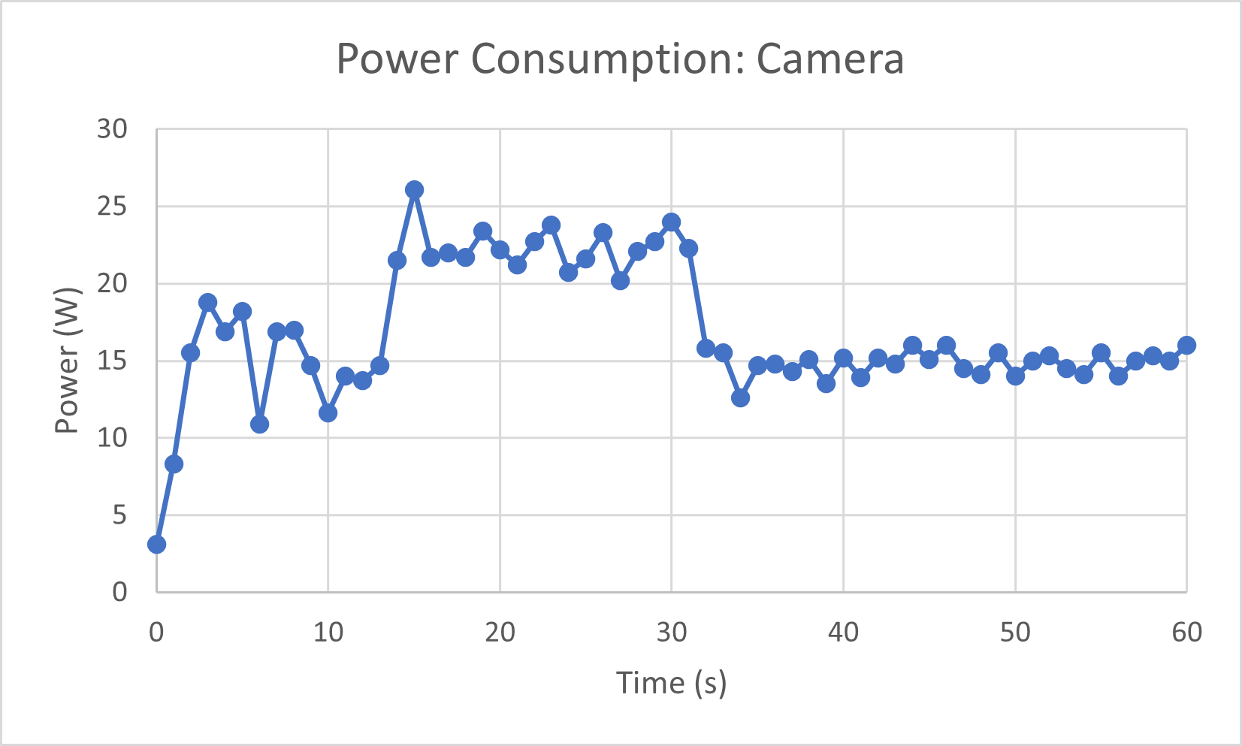
YOLO on a Laptop
Idle power for both tests are about 3.5W.
Average Power for Image Testset is 20.1W, and 17.2W for live camera.
Power Consumed is 16.3W for the testset, and 14.13W for the camera.
Overall results:
Image testset consumes more power than live camera feed.
Image testset performs better than the live camera but at the cost of consuming more power.

Slide 8
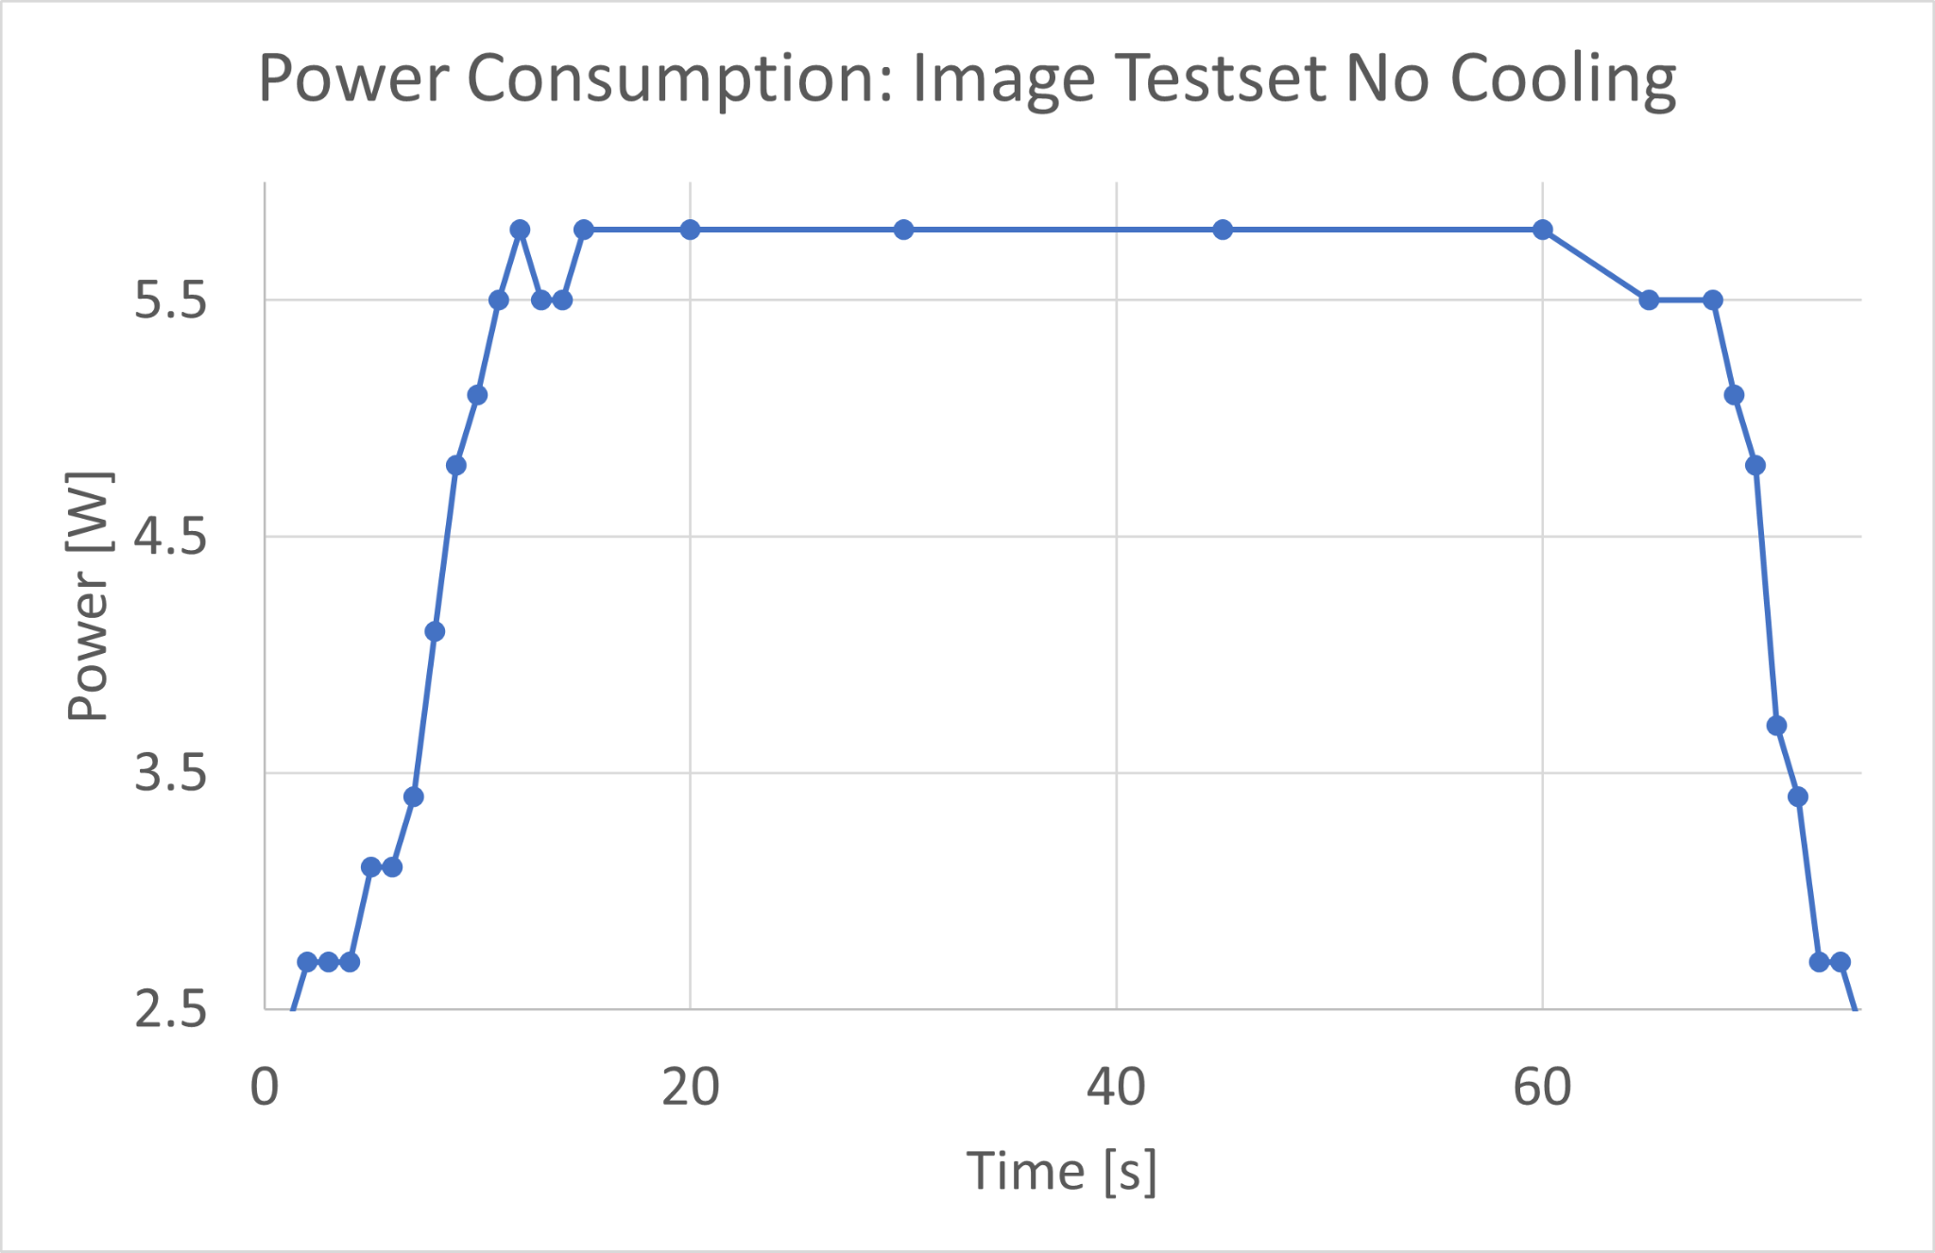
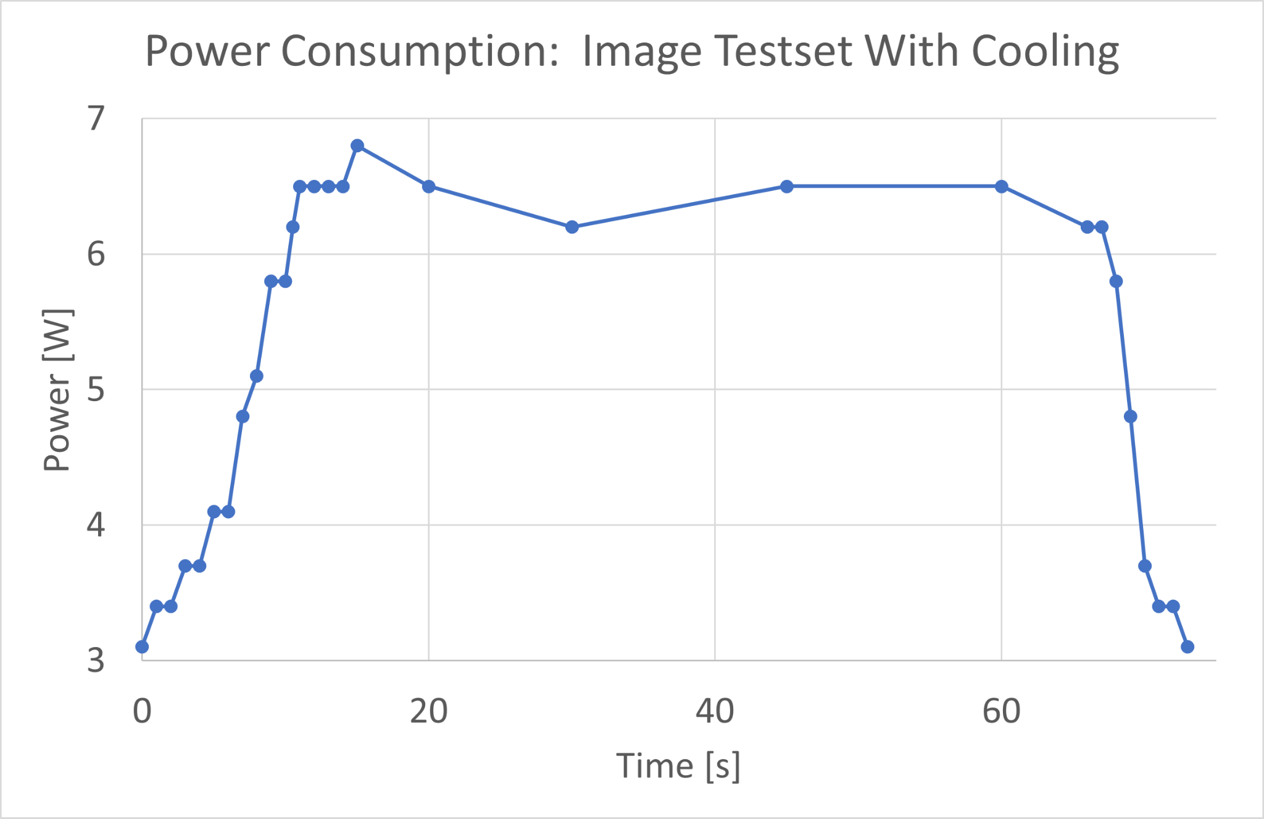
YOLO On The Pi - Detection From File
Two tests with two configurations
Detection from file and from webcam
Cooling from a fan and no cooling
Measured inference time and power
The file test used the image test dataset.
Results: | Cooling | No Cooling
Average FPS | 0.65 | 0.47
Average Inference Time | 1520 | 2600
Average Power | 6.0 | 5.2

Slide 9
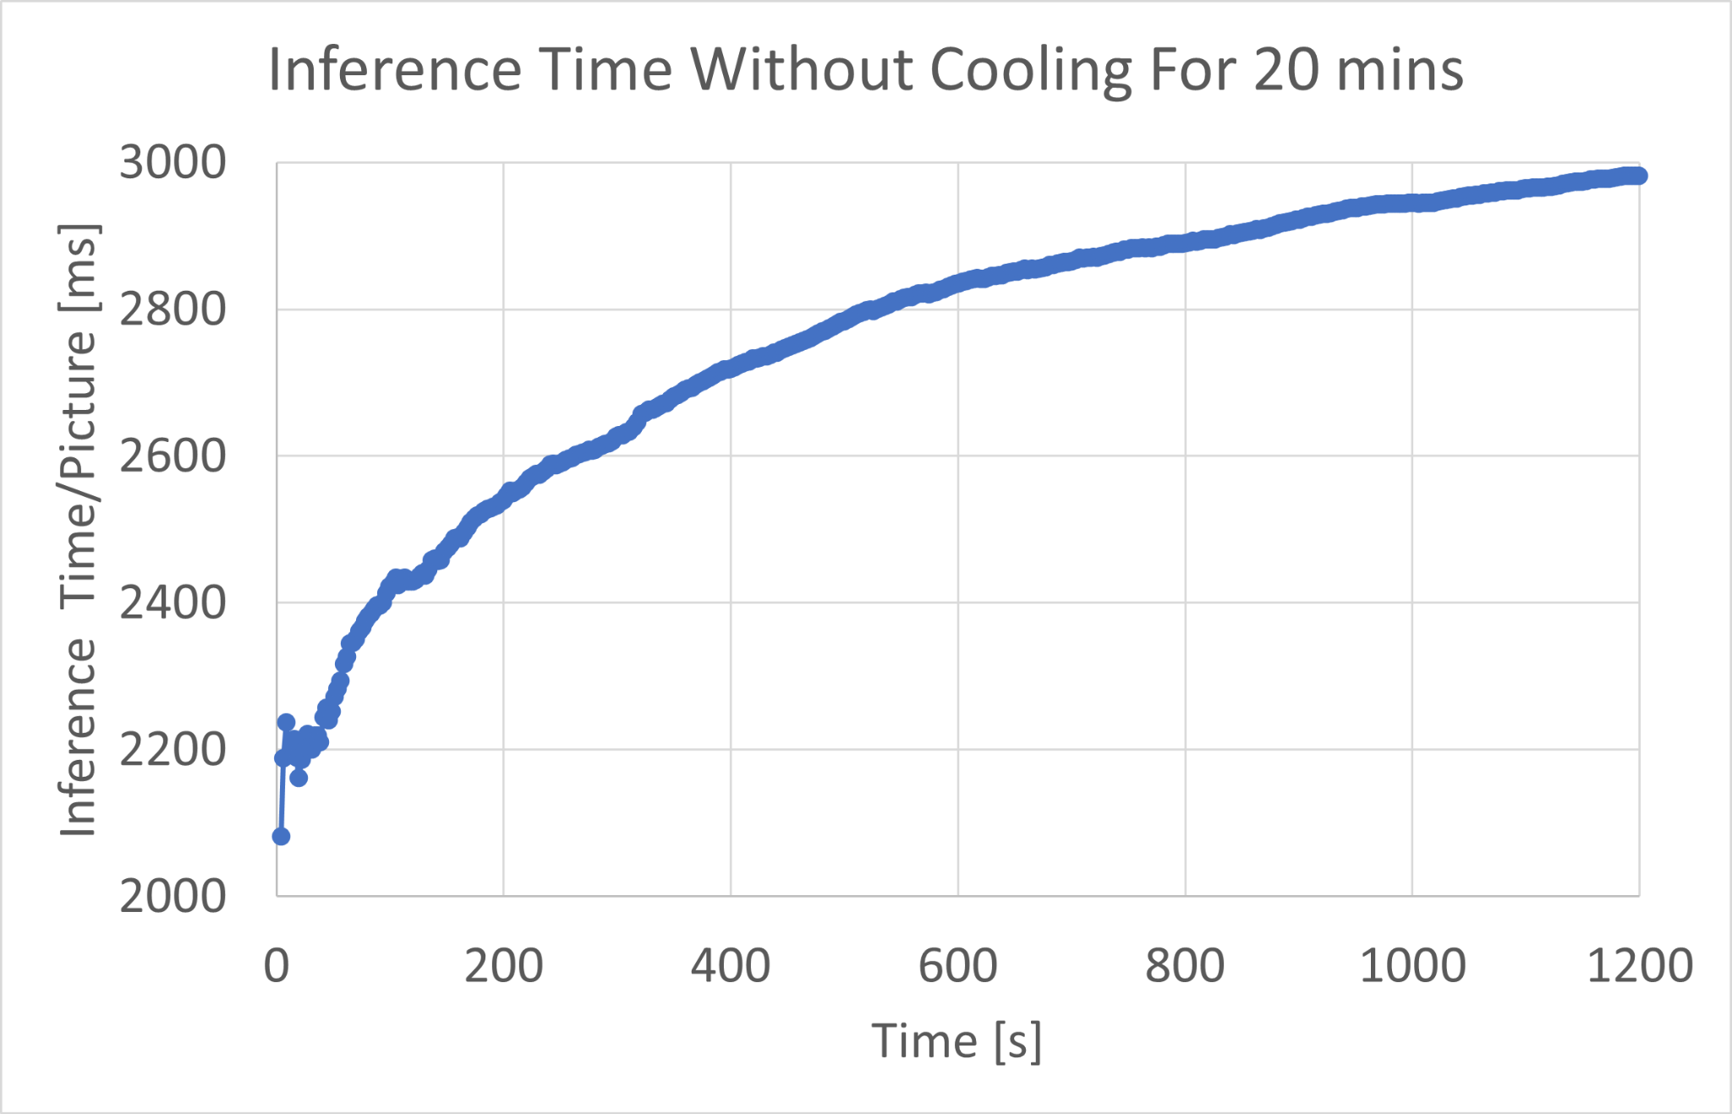
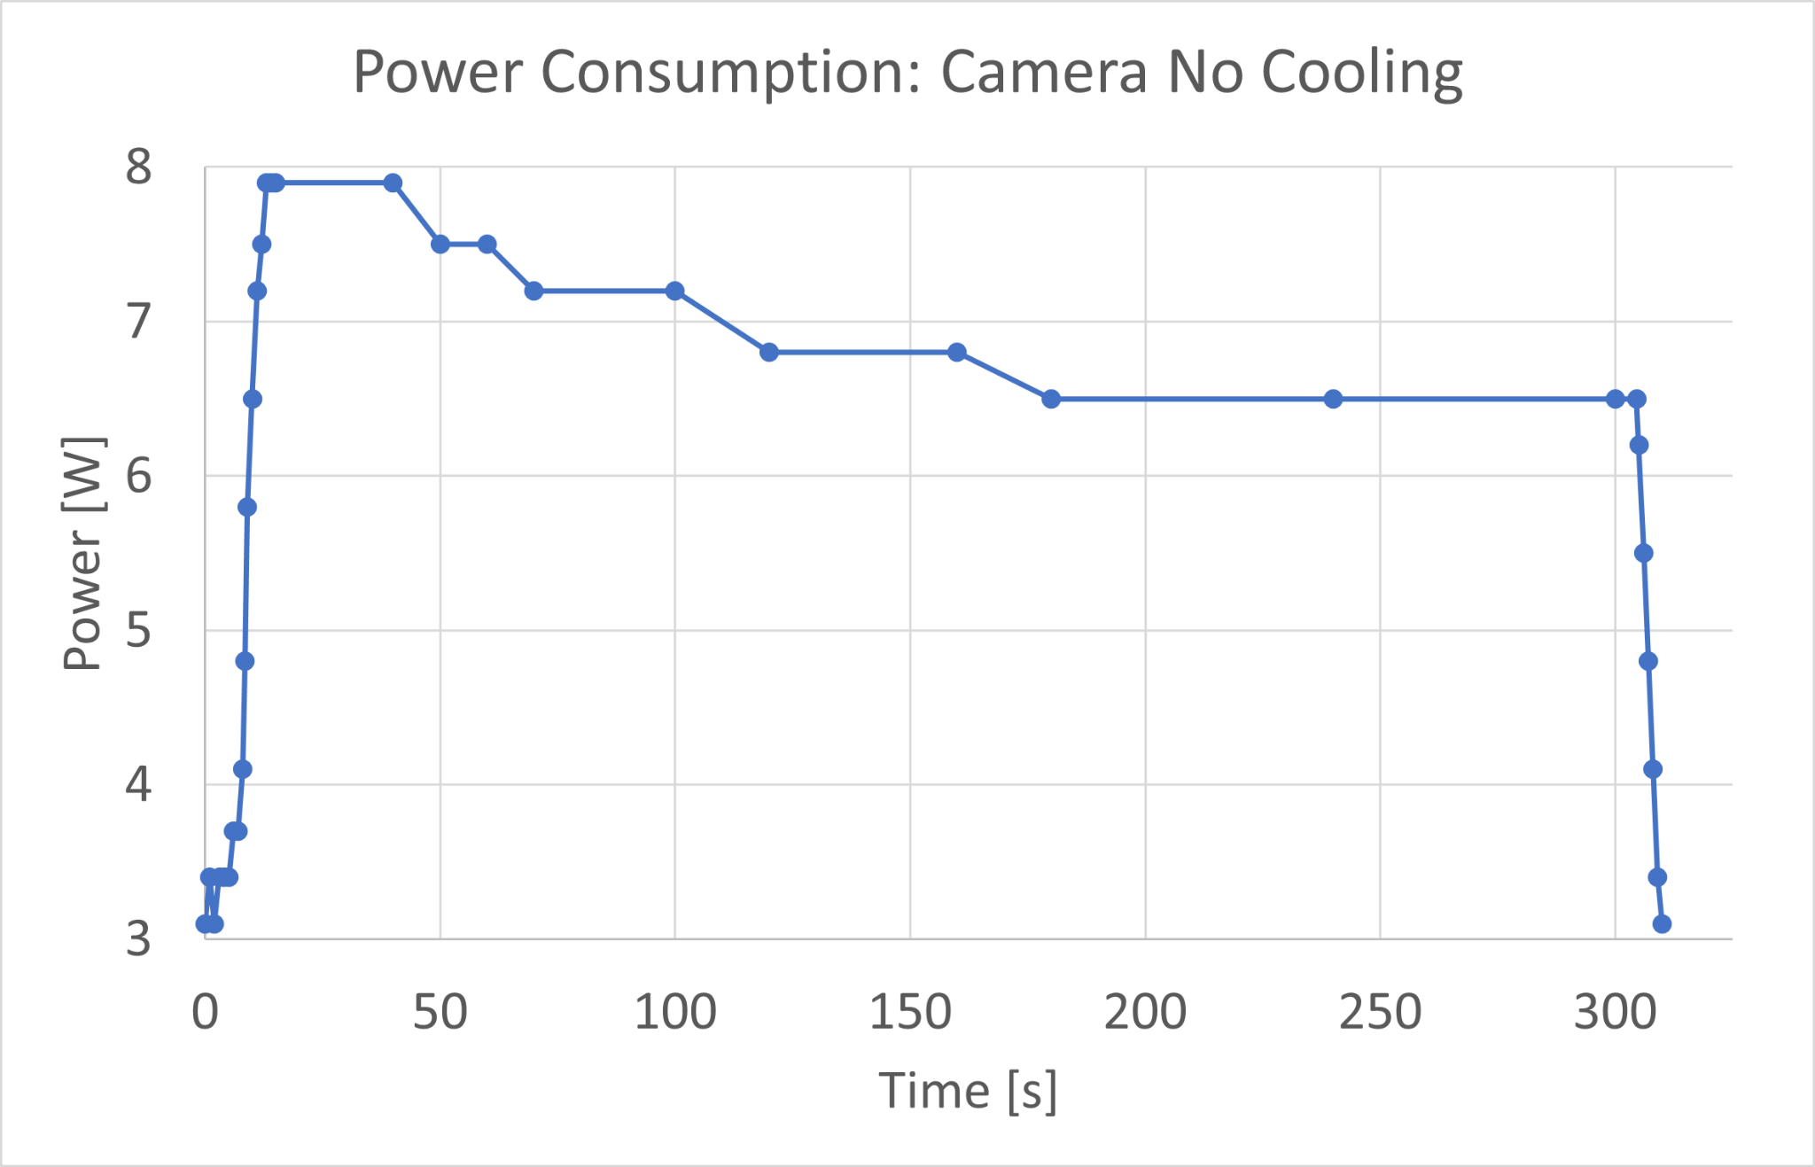
YOLO On The Pi - Detection From Webcam: No Cooling
Without cooling, the inference time increased logarithmically and approached 3s to process a single frame.
The power consumption was high initially but slowly decayed until it stabilized at 6.5W.

Slide 10
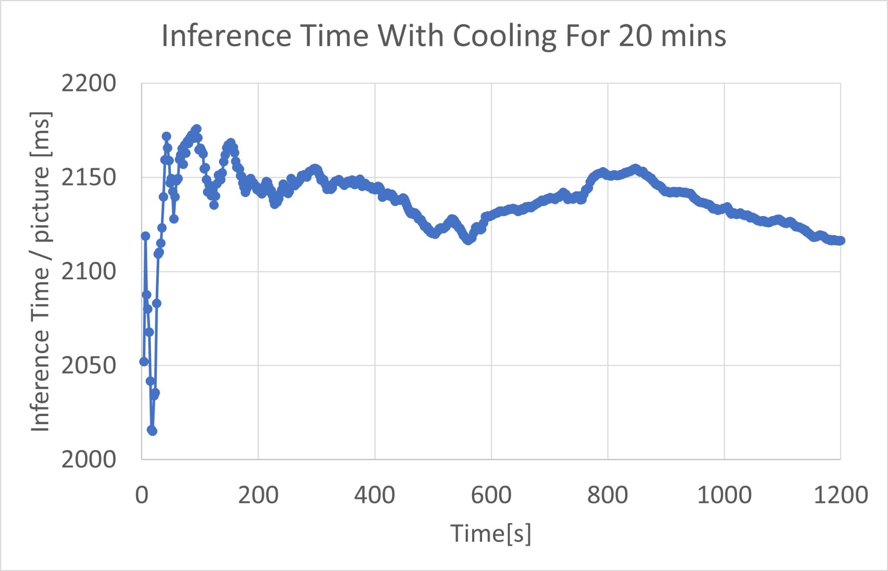
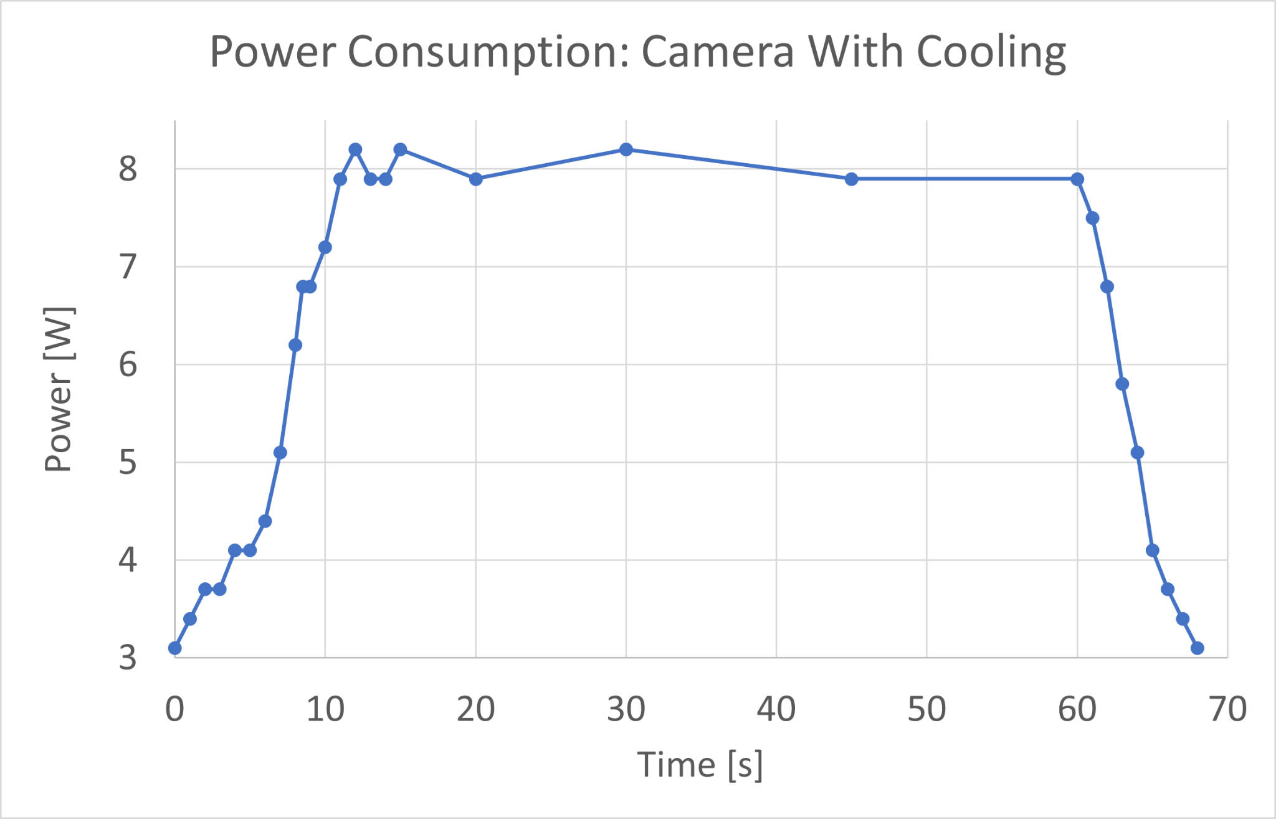
YOLO On The Pi - Detection From Webcam: Cooling
Without cooling, the inference time had a much smaller range and once stabilized, the inference time was between 2.1 and 2.2 seconds.
The power drawn by the Pi stabilized at 8.0W while it was classifying the images.

Slide 11
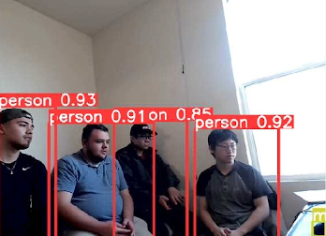
YOLO On The Pi - Evaluation
The Raspberry Pi can run the YOLOv5 algorithm on images and a camera feed, but the performance is unacceptable for many practical applications.
When working with smaller devices cooling is an important factor that will influence the power drawn and the stability of the system.
If the Raspberry Pi is to be used in a practical application, the algorithm used must be less computationally intensive.

Slide 12
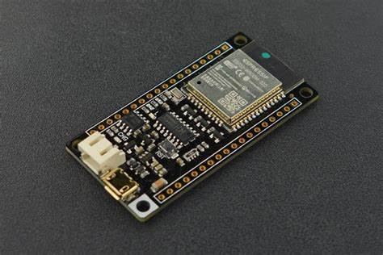
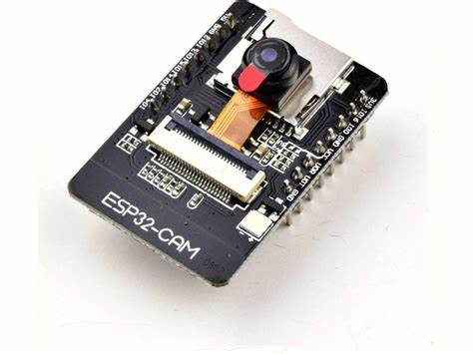
Microcontroller - ESP32 & ESP32Cam
Alternative
Yolo can not run directly on the microcontroller
Need to use a device that can run an algorithm for object detection
Laptop
ESP32 microcontroller and ESP32 cam data needs to be streamed to the laptop which uses YOLOv5 for object detection
Raspberry pi
ESP32 microcontroller and ESP32 cam data needs to be streamed to the Raspberry pi
Uses a different algorithm, TensorFlow

Slide 13
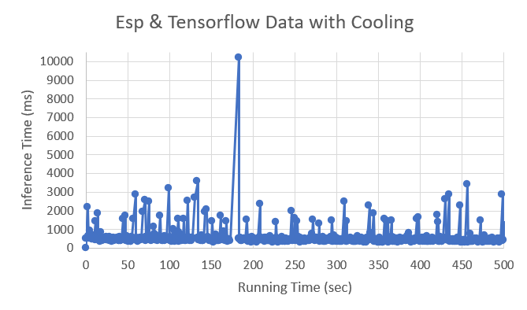
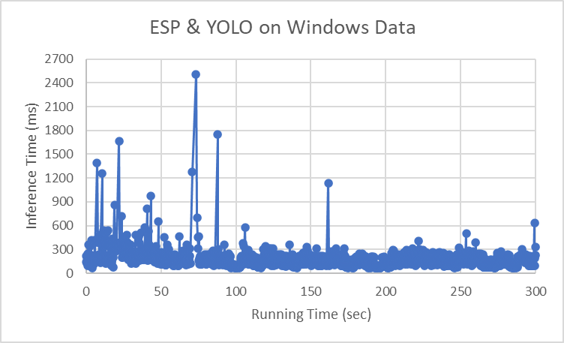
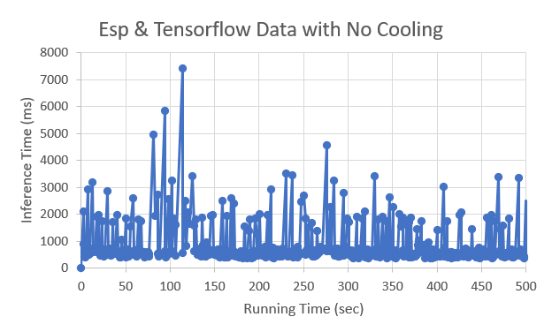
Microcontroller - ESP32 & ESP32Cam

Slide 14
Microcontroller - ESP32 & ESP32Cam
ESP and TensorFlow | Cooling | No cooling
Average FPS | 1.90 s | 1.28 s
Average Inference Time | 525.67 ms | 783.43 ms
Spikes in processing time is latency caused by the network.
When cooling is applied to the ESP and TensorFlow, the performance time improves
Performance of ESP32 and YOLO on windows is faster compared to the use of the TensorFlow algorithm
Power from the ESP32 microcontroller and ESP32 cam is negligible
When connected with the Raspberry pi, the power of the Raspberry pi is increased from an ideal 2.7 watts to an unstable 3.4 watts
ESP & YOLO on Windows | Average FPS | Average Inference Time
 | 6.04 s | 165.61 ms

Slide 15
Conclusion
YOLOv5 is powerful when applied to problems requiring computer vision, but is computationally intensive.
Modern PCs have the capabilities to process frames and perform inferences fast enough to be useful in many applications.
YOLOv5 underperforms on the Raspberry Pi, but a less intensive algorithm such as TensorFlow lite runs with greater success.
YOLOv5 is infeasible for many microcontrollers, but is capable of running less intensive algorithms like TensorFlow lite.
It is possible to implement YOLOv5 on the microcontroller by streaming the video feed from the microcontroller, and process it on another machine, and have the microcontroller respond accordingly.
This method accrues additional costs and forces internet constraints that bottlenecks the overall system.

Slide 16
References
Ultralytics (2022) YOLOv5 (Version 7.0) [Source Code] https://github.com/ultralytics/yolov5
FreedoomTechWeb (2022) YOLOv5Raspberry Pi 4 [Source Code] https://github.com/freedomwebtech/yolov5raspberry-pi4
TensorFlow (2022) TensorFlow (Version 2.11.0) [Source Code] https://github.com/tensorflow/tensorflow
FreedoomTechWeb (2022) ESP32Cam Object Detection [Source Code] https://github.com/freedomwebtech/esp32camobjectdetection
KUMAN Power Meter KW47 User Manual, KUMAN. Accessed: Sep. 30, 2022. [Online]. Available: https://manuals.plus/kuman/kw47-power-meter-manual
Lauren Hinkel | MIT-IBM Watson AI Lab, “Tiny Machine Learning Design alleviates a bottleneck in memory usage on internet-of-things devices,” MIT News | Massachusetts Institute of Technology. [Online]. Available: https://news.mit.edu/2021/tiny-machine-learning-design-alleviates-bottleneck-memory-usage-iot-devices-1208. [Accessed: 26-Nov-2022].

Slide 17
References
M. Stewart, “Tiny Machine Learning: The next ai revolution,” Medium, 03-Oct-2020. [Online]. Available: https://towardsdatascience.com/tiny-machine-learning-the-next-ai-revolution-495c26463868. [Accessed: 26-Nov-2022].
D. Davies, “Yolov5 object detection on windows (step-by-step tutorial),” W\&B, 20-Sep-2021. [Online]. Available: https://wandb.ai/onlineinference/YOLO/reports/YOLOv5-Object-Detection-on-Windows-Step-By-Step-Tutorial---VmlldzoxMDQwNzk4. [Accessed: 26-Nov-2022].
J. Cohen, “How to optimize a deep learning model for faster inference?,” Think Autonomous, 19-Oct-2022. [Online]. Available: https://www.thinkautonomous.ai/blog/deep-learning-optimization/. [Accessed: 26-Nov-2022].

Slide 18
References
D. R. Parthasarathi, “Computer Architecture,” Performance Metrics – Computer Architecture, 24-Jul-2018. [Online]. Available: https://www.cs.umd.edu/~meesh/411/CA-online/chapter/performance-metrics/index.html. [Accessed: 26-Nov-2022].
Core Temp. [Online]. Available: https://www.alcpu.com/CoreTemp/. [Accessed: 26-Nov-2022].
“Advantages and disadvantages of microcontroller,” Polytechnic Hub, Apr. 13, 2017. https://www.polytechnichub.com/advantages-disadvantages-microcontroller/ [Accessed Nov. 27, 2022].
IBM Cloud Education, “What is Machine Learning?,” IBM, Jul. 15, 2020. https://www.ibm.com/cloud/learn/machine-learning [Accessed Nov. 27, 2022].
M. Lab, “Microcontroller Memory Organization and Types - Explained with Memory Segments,” Microcontrollers Lab, Aug. 15, 2020. https://microcontrollerslab.com/microcontroller-memory-organization-types-memory-segments/ [Accessed Nov. 27, 2022].

